Slide 1
Capsule Networks: A Survey
Yogesh Rawat
CVPR Tutorial
Sunday, June 16, 2019

Slide 6
Outline
Introduction
Early work
Foundational work
Video capsules

Slide 7
Outline
Introduction
Routing
Dynamic vs EM
Attention
Multi-modal
Generic
Fast dynamic routing

Slide 8
Outline
Introduction
Routing
Modality
Visual: images and videos
Text
Graph
3D point cloud

Slide 9
Outline
Introduction
Routing
Modality
Problem domain
Classification
Segmentation
Localization

Slide 10
Outline
Introduction
Routing
Modality
Problem domain
Applications
Relation extraction
Adversary detection
Brain tumor classification
Breast cancer detection

Slide 11
Outline
Introduction
Early work [1,2]
Foundational work [3,4]
Video capsules [5]
Hinton, Geoffrey E., Alex Krizhevsky, and Sida D. Wang. "Transforming auto-encoders." International Conference on Artificial Neural Networks. 2011.
Kulkarni, Tejas D., William F. Whitney, Pushmeet Kohli, and Josh Tenenbaum. "Deep convolutional inverse graphics network." In Advances in neural information processing systems,. 2015.
Sabour, Sara, Nicholas Frosst, and Geoffrey E. Hinton. "Dynamic routing between capsules." Advances in neural information processing systems. 2017.
Hinton, Geoffrey E., Sara Sabour, and Nicholas Frosst. "Matrix capsules with EM routing." International Conference on Learning Representations. 2018.
Duarte, Kevin, Yogesh Rawat, and Mubarak Shah. "Videocapsulenet: A simplified network for action detection." Advances in Neural Information Processing Systems. 2018.

Slide 12
Introduction
Vector of instantiation parameters
Auto-encoders [1]
[1] Hinton, Geoffrey E., Alex Krizhevsky, and Sida D. Wang. "Transforming auto-encoders.“
International Conference on Artificial Neural Networks. Springer, Berlin, Heidelberg, 2011.

Slide 13
Introduction
Vector of instantiation parameters
Auto-encoders [1]
[1] Hinton, Geoffrey E., Alex Krizhevsky, and Sida D. Wang. "Transforming auto-encoders.“
International Conference on Artificial Neural Networks. Springer, Berlin, Heidelberg, 2011.

Slide 14
Introduction
Vector of instantiation parameters
Auto-encoders [1]
[1] Hinton, Geoffrey E., Alex Krizhevsky, and Sida D. Wang. "Transforming auto-encoders.“
International Conference on Artificial Neural Networks. Springer, Berlin, Heidelberg, 2011.

Slide 15
Introduction
Vector of instantiation parameters
Auto-encoders [1]
[1] Hinton, Geoffrey E., Alex Krizhevsky, and Sida D. Wang. "Transforming auto-encoders.“
International Conference on Artificial Neural Networks. Springer, Berlin, Heidelberg, 2011.

Slide 16
Introduction
Vector of instantiation parameters
Auto-encoders [1]
[1] Hinton, Geoffrey E., Alex Krizhevsky, and Sida D. Wang. "Transforming auto-encoders.“
International Conference on Artificial Neural Networks. Springer, Berlin, Heidelberg, 2011.

Slide 17
Introduction
Vector of instantiation parameters
Auto-encoders [1]
[1] Hinton, Geoffrey E., Alex Krizhevsky, and Sida D. Wang. "Transforming auto-encoders.“
International Conference on Artificial Neural Networks. Springer, Berlin, Heidelberg, 2011.

Slide 18
Introduction
Vector of instantiation parameters
Auto-encoders [1]
[1] Hinton, Geoffrey E., Alex Krizhevsky, and Sida D. Wang. "Transforming auto-encoders.“
International Conference on Artificial Neural Networks. Springer, Berlin, Heidelberg, 2011.

Slide 19
Introduction
Vector of instantiation parameters
Auto-encoders [1]
[1] Hinton, Geoffrey E., Alex Krizhevsky, and Sida D. Wang. "Transforming auto-encoders.“
International Conference on Artificial Neural Networks. Springer, Berlin, Heidelberg, 2011.

Slide 20
Introduction
Vector of instantiation parameters
Convolutional inverse graphics [2]
[2] Kulkarni, Tejas D., William F. Whitney, Pushmeet Kohli, and Josh Tenenbaum. "Deep convolutional inverse graphics network."
In Advances in neural information processing systems,. 2015.

Slide 21
Introduction
Vector of instantiation parameters
Convolutional inverse graphics [2]
[2] Kulkarni, Tejas D., William F. Whitney, Pushmeet Kohli, and Josh Tenenbaum. "Deep convolutional inverse graphics network."
In Advances in neural information processing systems,. 2015.

Slide 22
Introduction
Vector of instantiation parameters
Convolutional inverse graphics [2]
[2] Kulkarni, Tejas D., William F. Whitney, Pushmeet Kohli, and Josh Tenenbaum. "Deep convolutional inverse graphics network."
In Advances in neural information processing systems,. 2015.

Slide 23
Introduction
Vector of instantiation parameters
Convolutional inverse graphics [2]
[2] Kulkarni, Tejas D., William F. Whitney, Pushmeet Kohli, and Josh Tenenbaum. "Deep convolutional inverse graphics network."
In Advances in neural information processing systems,. 2015.

Slide 24
Introduction
Vector of instantiation parameters
Convolutional inverse graphics [2]
[2] Kulkarni, Tejas D., William F. Whitney, Pushmeet Kohli, and Josh Tenenbaum. "Deep convolutional inverse graphics network."
In Advances in neural information processing systems,. 2015.

Slide 25
Introduction
Vector of instantiation parameters
Convolutional inverse graphics
Dynamic routing [3]
[3] Sabour, Sara, Nicholas Frosst, and Geoffrey E. Hinton. "Dynamic routing between capsules.“ Advances in neural information processing systems. 2017.

Slide 26
Introduction
Vector of instantiation parameters
Convolutional inverse graphics
Dynamic routing
EM routing [4]
Disentangle pose/activation
[4] Hinton, Geoffrey E., Sara Sabour, and Nicholas Frosst. "Matrix capsules with EM routing.“ ICLR (2018).

Slide 27
Introduction
Vector of instantiation parameters
Convolutional inverse graphics
Dynamic routing
EM routing
Video capsules [5]
[5] Duarte, Kevin, Yogesh Rawat, and Mubarak Shah. "Videocapsulenet: A simplified network for action detection." Advances in Neural Information Processing Systems. 2018.

Slide 28
Generalization to video
Scalability issue
High dimensional data
Too many capsules
High memory consumption
Slow routing
VideoCapsuleNet [5]
Capsule pooling
Shared transformations
[5] Duarte, Kevin, Yogesh Rawat, and Mubarak Shah. "Videocapsulenet: A simplified network for action detection." Advances in Neural Information Processing Systems. 2018.

Slide 29
Outline
Sabour, Sara, Nicholas Frosst, and Geoffrey E. Hinton. "Dynamic routing between capsules." NeurIPS. 2017.
Hinton, Geoffrey E., Sara Sabour, and Nicholas Frosst. "Matrix capsules with EM routing." ICLR. 2018.
McIntosh, Bruce, Kevin Duarte, Yogesh S. Rawat, and Mubarak Shah. "Multi-modal Capsule Routing for Actor and Action Video Segmentation Conditioned on Natural Language Queries.” preprint (2018).
Lenssen, Jan Eric, Matthias Fey, and Pascal Libuschewski. "Group equivariant capsule networks." NeurIPS. 2018.
Li, Hongyang, Xiaoyang Guo, Bo DaiWanli Ouyang, and Xiaogang Wang. "Neural network encapsulation, ECCV, 2018.
Introduction
Routing
Dynamic vs EM [1,2]
Attention
Multi-modal [3]
Generic [4]
Fast dynamic routing [5]
Zhang, Suofei, Quan Zhou, and Xiaofu Wu. "Fast dynamic routing based on weighted kernel density estimation." In International Symposium on Artificial Intelligence and Robotics, pp. 301-309. Springer, Cham, 2018.
Wang, Dilin, and Qiang Liu. "An optimization view on dynamic routing between capsules." International Conference on Learning Representations Workshop (2018).
Chen, Zhenhua, and David Crandall. "Generalized capsule networks with trainable routing procedure." arXiv preprint arXiv:1808.08692 (2018).
Shahroudnejad, Atefeh, Parnian Afshar, Konstantinos N. Plataniotis, and Arash Mohammadi. "Improved explainability of capsule networks: Relevance path by agreement." In 2018 IEEE Global Conference on Signal and Information Processing (GlobalSIP), pp. 549-553. IEEE, 2018.

Slide 30
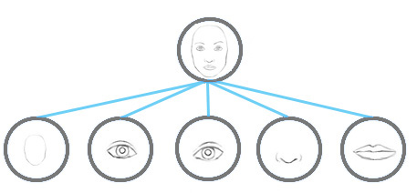
Routing
Transforming low-level capsules to higher level capsules
Parts-to-whole relationship
Dynamic routing [3] and EM routing [4]
Learning of these transformations
[3] Sabour, Sara, Nicholas Frosst, and Geoffrey E. Hinton. "Dynamic routing between capsules." Advances in neural information processing systems. 2017.
[4] Hinton, Geoffrey E., Sara Sabour, and Nicholas Frosst. "Matrix capsules with EM routing." ICLR (2018).
Image source: https://jhui.github.io

Slide 31
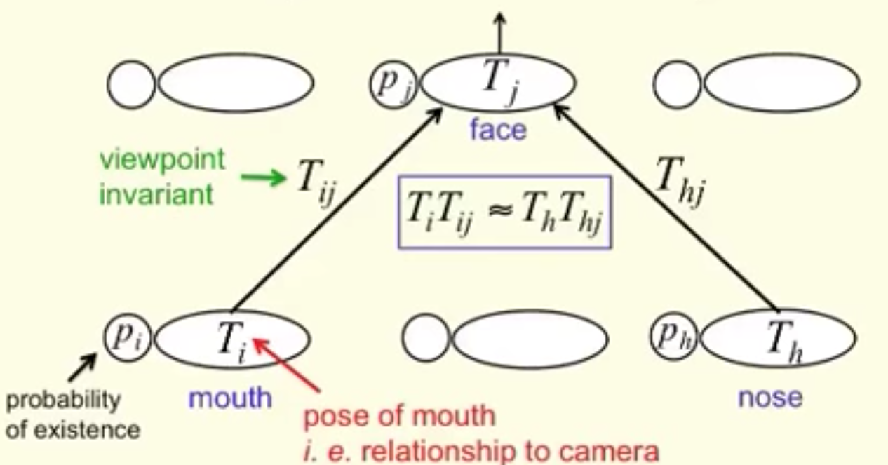
Dynamic vs EM routing
Both are iterative
Dynamic
Squash function
Cosine similarity
EM
Existence probability
Distribution
[3] Sabour, Sara, Nicholas Frosst, and Geoffrey E. Hinton. "Dynamic routing between capsules." Advances in neural information processing systems. 2017.
[4] Hinton, Geoffrey E., Sara Sabour, and Nicholas Frosst. "Matrix capsules with EM routing." ICLR (2018).
Image source: https://jhui.github.io

Slide 32
Generic routing by agreement
Equivariance and invariance [5]
[5] Lenssen, Jan Eric, Matthias Fey, and Pascal Libuschewski. "Group equivariant capsule networks.“
Advances in Neural Information Processing Systems. 2018.

Slide 33
Equivariance and Invariance
Variation in pose vector
[5] Lenssen, Jan Eric, Matthias Fey, and Pascal Libuschewski. "Group equivariant capsule networks.“
Advances in Neural Information Processing Systems. 2018.

Slide 34
Fast dynamic routing
Capsule encapsulation [6]
[6] Li, Hongyang, Xiaoyang Guo, Bo DaiWanli Ouyang, and Xiaogang Wang. "Neural network encapsulation”
Proceedings of the European Conference on Computer Vision (ECCV). 2018.

Slide 35
Fast dynamic routing
Capsule encapsulation [6]
[6] Li, Hongyang, Xiaoyang Guo, Bo DaiWanli Ouyang, and Xiaogang Wang. "Neural network encapsulation”
Proceedings of the European Conference on Computer Vision (ECCV). 2018.

Slide 36
Fast dynamic routing
Capsule encapsulation [6]
[6] Li, Hongyang, Xiaoyang Guo, Bo DaiWanli Ouyang, and Xiaogang Wang. "Neural network encapsulation”
Proceedings of the European Conference on Computer Vision (ECCV). 2018.

Slide 37
Another notion of capsule
CapProNet [14]
[14] Zhang, Liheng, Marzieh Edraki, and Guo-Jun Qi. "CapProNet: Deep feature learning via orthogonal projections onto capsule subspaces." Advances in Neural Information Processing Systems. 2018.

Slide 38
Outline
Introduction
Routing
Modality
Visual: images, videos
Text [9]
Graph [10]
3D point cloud [11]
Multi-modal [12]
[9] Zhao, Wei, Jianbo Ye, Min Yang, Zeyang Lei, Suofei Zhang, and Zhou Zhao."Investigating capsule networks with dynamic routing for text classification." EMNLP (2018).
[10] Xinyi, Zhang, and Lihui Chen. "Capsule Graph Neural Network." ICLR (2018).
[11] Zhao, Yongheng, Tolga Birdal, Haowen Deng, and Federico Tombari. "3D Point-Capsule Networks." CVPR, (2019).
[12] McIntosh, Bruce, Kevin Duarte, Yogesh S. Rawat, and Mubarak Shah. "Multi-modal Capsule Routing for Actor and Action Video Segmentation Conditioned on Natural Language Queries.” preprint (2018).
Verma, Saurabh, and Zhi-Li Zhang. "Graph capsule convolutional neural networks." ICML Workshop (2018).
Kim, Jaeyoung, Sion Jang, Sungchul Choi, and Eunjeong Park. "Text Classification using Capsules." arXiv preprint arXiv:1808.03976 (2018).
Algamdi, Abdullah M., Victor Sanchez, and Chang-Tsun Li. "Learning Temporal Information from Spatial Information Using CapsNets for Human Action Recognition." In ICASSP 2019-2019 IEEE International Conference on Acoustics, Speech and Signal Processing (ICASSP), IEEE, 2019.
Ertugrul, Itir Onal, László A. Jeni, and Jeffrey F. Cohn. "FACSCaps: Pose-Independent Facial Action Coding with Capsules." In IEEE (CVPRW), 2018.

Slide 39
Text capsules
[9] Zhao, Wei, Jianbo Ye, Min Yang, Zeyang Lei, Suofei Zhang, and Zhou Zhao. "Investigating capsule networks with dynamic routing for text classification."EMNLP (2018).

Slide 40
Text capsules
[9] Zhao, Wei, Jianbo Ye, Min Yang, Zeyang Lei, Suofei Zhang, and Zhou Zhao. "Investigating capsule networks with dynamic routing for text classification."EMNLP (2018).

Slide 41
Text capsules
[9] Zhao, Wei, Jianbo Ye, Min Yang, Zeyang Lei, Suofei Zhang, and Zhou Zhao. "Investigating capsule networks with dynamic routing for text classification."EMNLP (2018).

Slide 42
Text capsules
[9] Zhao, Wei, Jianbo Ye, Min Yang, Zeyang Lei, Suofei Zhang, and Zhou Zhao. "Investigating capsule networks with dynamic routing for text classification."EMNLP (2018).

Slide 43
Text capsules
[9] Zhao, Wei, Jianbo Ye, Min Yang, Zeyang Lei, Suofei Zhang, and Zhou Zhao. "Investigating capsule networks with dynamic routing for text classification."EMNLP (2018).

Slide 44
Text capsules
[9] Zhao, Wei, Jianbo Ye, Min Yang, Zeyang Lei, Suofei Zhang, and Zhou Zhao. "Investigating capsule networks with dynamic routing for text classification."EMNLP (2018).

Slide 45
Graph capsules
[10] Xinyi, Zhang, and Lihui Chen. "Capsule Graph Neural Network." ICLR (2018).

Slide 46
Graph capsules
[10] Xinyi, Zhang, and Lihui Chen. "Capsule Graph Neural Network." ICLR (2018).

Slide 47
Graph capsules
[10] Xinyi, Zhang, and Lihui Chen. "Capsule Graph Neural Network." ICLR (2018).

Slide 48
Graph capsules
[10] Xinyi, Zhang, and Lihui Chen. "Capsule Graph Neural Network." ICLR (2018).

Slide 49
3D point cloud
[11] Zhao, Yongheng, Tolga Birdal, Haowen Deng, and Federico Tombari. "3D Point-Capsule Networks." CVPR, (2019).

Slide 50
Multi-modal
Visual and text
[12] McIntosh, Bruce, Kevin Duarte, Yogesh S. Rawat, and Mubarak Shah. "Multi-modal Capsule Routing for Actor and Action Video Segmentation Conditioned on Natural Language Queries.” preprint (2018).

Slide 51
Deeper capsule network
Multiple capsule layers [13]
Class-independent decoder
Better regularization
[13] Rajasegaran, Jathushan, Vinoj Jayasundara, Sandaru Jayasekara, Hirunima Jayasekara, Suranga Seneviratne, and Ranga Rodrigo. "DeepCaps: Going Deeper with Capsule Networks." CVPR 2019.

Slide 52
Outline
Introduction
Routing
Modality
Problem domain

Slide 53
Problem domain
Classification
Segmentation
Localization
Sabour, Sara, Nicholas Frosst, and Geoffrey E. Hinton. "Dynamic routing between capsules." Advances in neural information processing systems. 2017.
Hinton, Geoffrey E., Sara Sabour, and Nicholas Frosst. "Matrix capsules with EM routing." International Conference on Learning Representations. 2018.
Du, Yongping, Xiaozheng Zhao, Meng He, and Wenyang Guo. "A Novel Capsule Based Hybrid Neural Network for Sentiment Classification." IEEE Access 7 (2019): 39321-39328.
LaLonde, Rodney, and Ulas Bagci. "Capsules for object segmentation." Medical Imaging with Deep Learning (2018).
Duarte, Kevin, Yogesh Rawat, and Mubarak Shah. "Videocapsulenet: A simplified network for action detection." Advances in Neural Information Processing Systems. 2018.
McIntosh, Bruce, Kevin Duarte, Yogesh S. Rawat, and Mubarak Shah. "Multi-modal Capsule Routing for Actor and Action Video Segmentation Conditioned on Natural Language Queries." arXiv preprint (2018).

Slide 54
Classification
Image, video, text, graph, etc.
[4] Hinton, Geoffrey E., Sara Sabour, and Nicholas Frosst. "Matrix capsules with EM routing.“ ICLR (2018).

Slide 55
Segmentation
[15] LaLonde, Rodney, and Ulas Bagci. "Capsules for Object Segmentation." (2018). Conference on Medical Imaging with Deep Learning (MIDL 2018),

Slide 56
Localization
[8] Duarte, Kevin, Yogesh Rawat, and Mubarak Shah. "Videocapsulenet: A simplified network for action detection." NeurIPS. 2018.

Slide 57
Outline
Introduction
Routing
Modality
Problem domain
Applications

Slide 58
Applications
Zhang, Xinsong, Pengshuai Li, Weijia Jia, and Hai Zhao. "Multi-labeled Relation Extraction with Attentive Capsule Network." AAAI (2018).
Zhang, Ningyu, Shumin Deng, Zhanlin Sun, Xi Chen, Wei Zhang, and Huajun Chen. "Attention-Based Capsule Networks with Dynamic Routing for Relation Extraction.“ EMNLP 2018
Afshar, Parnian, Arash Mohammadi, and Konstantinos N. Plataniotis. "Brain tumor type classification via capsule networks." ICIP, 2018.
Jinliang Guo, Fang Fang, Wei Wang, Fuji Ren: EEG Emotion Recognition Based on Granger Causality and CapsNet Neural Network. CCIS, 2018.
5.Lesmantas, Tomas, and Robertas Alzbutas. "Convolutional capsule network for classification of breast cancer histology images." ICIAR, 2018.
Relation extraction [1, 2]
Adversary detection [3]
Brain tumor classification [4]
Classification of Breast Cancer [5]
Mobiny, Aryan, Hengyang Lu, Hien V. Nguyen, Badrinath Roysam, and Navin Varadarajan. "Automated Classification of Apoptosis in Phase Contrast Microscopy Using Capsule Network." IEEE transactions on medical imaging (2019).
A. PV, K. M. Buddhiraju and A. Porwal, "Capsulenet-Based Spatial–Spectral Classifier for Hyperspectral Images," in IEEE Journal of Selected Topics in Applied Earth Observations and Remote Sensing. 2019
Jinliang Guo, Fang Fang, Wei Wang, Fuji Ren: EEG Emotion Recognition Based on Granger Causality and CapsNet Neural Network. International Conference on Cloud Computing and Intelligence Systems, 2018
X. Wang, K. Tan, Q. Du, Y. Chen and P. Du, "Caps-TripleGAN: GAN-Assisted CapsNet for Hyperspectral Image Classification," in IEEE Transactions on Geoscience and Remote Sensing. 2019
Beşer, Fuat, Merve Ayyüce Kizrak, Bülent Bolat, and Tülay Yildirim. "Recognition of sign language using capsule networks." In 2018 26th Signal Processing and Communications Applications Conference (SIU), pp. 1-4. IEEE, 2018.
Zhao, Tianming, Yuanning Liu, Guang Huo, and Xiaodong Zhu. "A Deep Learning Iris Recognition Method Based on Capsule Network Architecture." IEEE Access 7 (2019): 49691-49701.
Marchisio, Alberto, Giorgio Nanfa, Faiq Khalid, Muhammad Abdullah Hanif, Maurizio Martina, and Muhammad Shafique. "CapsAttacks: Robust and Imperceptible Adversarial Attacks on Capsule Networks." International Conference on Machine Learning Workshop 8(2019).

Slide 59
Relation extraction
[18] Zhang, Xinsong, Pengshuai Li, Weijia Jia, and Hai Zhao. "Multi-labeled Relation Extraction with Attentive Capsule Network." AAAI (2018).

Slide 60
Relation extraction

Slide 61
Relation extraction

Slide 62
Relation extraction
[19] Zhang, Ningyu, Shumin Deng, Zhanlin Sun, Xi Chen, Wei Zhang, and Huajun Chen. "Attention-Based Capsule Networks with Dynamic Routing for Relation Extraction.“ EMNLP 2018

Slide 63
Relation extraction
[19] Zhang, Ningyu, Shumin Deng, Zhanlin Sun, Xi Chen, Wei Zhang, and Huajun Chen. "Attention-Based Capsule Networks with Dynamic Routing for Relation Extraction.“ EMNLP 2018

Slide 64
Relation extraction
[19] Zhang, Ningyu, Shumin Deng, Zhanlin Sun, Xi Chen, Wei Zhang, and Huajun Chen. "Attention-Based Capsule Networks with Dynamic Routing for Relation Extraction.“ EMNLP 2018

Slide 65
Relation extraction
[19] Zhang, Ningyu, Shumin Deng, Zhanlin Sun, Xi Chen, Wei Zhang, and Huajun Chen. "Attention-Based Capsule Networks with Dynamic Routing for Relation Extraction.“ EMNLP 2018

Slide 66
Relation extraction
[19] Zhang, Ningyu, Shumin Deng, Zhanlin Sun, Xi Chen, Wei Zhang, and Huajun Chen. "Attention-Based Capsule Networks with Dynamic Routing for Relation Extraction.“ EMNLP 2018

Slide 67
Relation extraction
[19] Zhang, Ningyu, Shumin Deng, Zhanlin Sun, Xi Chen, Wei Zhang, and Huajun Chen. "Attention-Based Capsule Networks with Dynamic Routing for Relation Extraction.“ EMNLP 2018

Slide 68
Detecting adversarial attack
[20] Frosst, Nicholas, Sara Sabour, and Geoffrey Hinton. "DARCCC: Detecting Adversaries by Reconstruction from Class Conditional Capsules." arXiv preprint arXiv:1811.06969(2018).

Slide 69
Detecting adversarial attack
[20] Frosst, Nicholas, Sara Sabour, and Geoffrey Hinton. "DARCCC: Detecting Adversaries by Reconstruction from Class Conditional Capsules." arXiv preprint arXiv:1811.06969(2018).

Slide 70
Detecting adversarial attack
[20] Frosst, Nicholas, Sara Sabour, and Geoffrey Hinton. "DARCCC: Detecting Adversaries by Reconstruction from Class Conditional Capsules." arXiv preprint arXiv:1811.06969(2018).

Slide 71
Reconstruction
[20] Frosst, Nicholas, Sara Sabour, and Geoffrey Hinton. "DARCCC: Detecting Adversaries by Reconstruction from Class Conditional Capsules." arXiv preprint arXiv:1811.06969(2018).

Slide 72
Reconstruction
[20] Frosst, Nicholas, Sara Sabour, and Geoffrey Hinton. "DARCCC: Detecting Adversaries by Reconstruction from Class Conditional Capsules." arXiv preprint arXiv:1811.06969(2018).

Slide 73
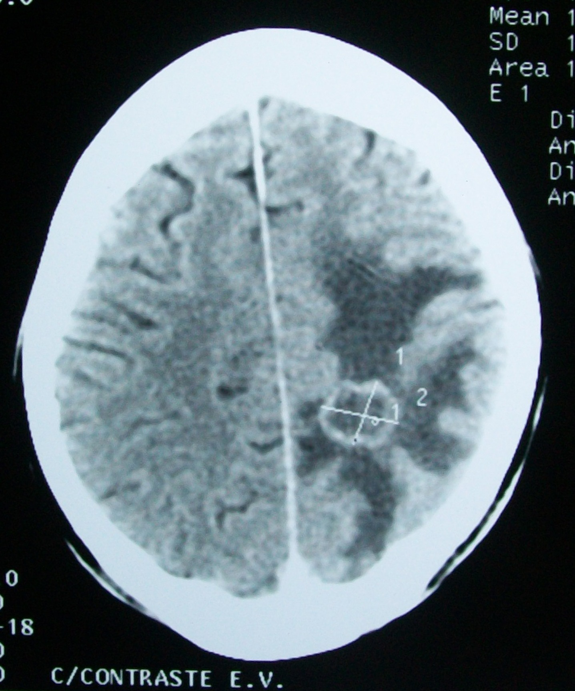
Brain tumor classification

Slide 74
Brain tumor classification
Afshar, Parnian, Arash Mohammadi, and Konstantinos N. Plataniotis. "Brain tumor type classification via capsule networks." 2018 25th IEEE International Conference on Image Processing (ICIP). IEEE, 2018.

Slide 75
Brain tumor classification
Afshar, Parnian, Arash Mohammadi, and Konstantinos N. Plataniotis. "Brain tumor type classification via capsule networks." 2018 25th IEEE International Conference on Image Processing (ICIP). IEEE, 2018.

Slide 76
Brain tumor classification
Afshar, Parnian, Arash Mohammadi, and Konstantinos N. Plataniotis. "Brain tumor type classification via capsule networks." 2018 25th IEEE International Conference on Image Processing (ICIP). IEEE, 2018.

Slide 77
Brain tumor classification
Afshar, Parnian, Arash Mohammadi, and Konstantinos N. Plataniotis. "Brain tumor type classification via capsule networks." 2018 25th IEEE International Conference on Image Processing (ICIP). IEEE, 2018.

Slide 78
Brain tumor classification
Afshar, Parnian, Arash Mohammadi, and Konstantinos N. Plataniotis. "Brain tumor type classification via capsule networks." 2018 25th IEEE International Conference on Image Processing (ICIP). IEEE, 2018.

Slide 79
Brain tumor classification
Effect of capsule activations
Afshar, Parnian, Arash Mohammadi, and Konstantinos N. Plataniotis. "Brain tumor type classification via capsule networks." 2018 25th IEEE International Conference on Image Processing (ICIP). IEEE, 2018.

Slide 80
Brain tumor classification
Effect of capsule activations
Afshar, Parnian, Arash Mohammadi, and Konstantinos N. Plataniotis. "Brain tumor type classification via capsule networks." 2018 25th IEEE International Conference on Image Processing (ICIP). IEEE, 2018.

Slide 81
Brain tumor classification
Effect of capsule activations
Afshar, Parnian, Arash Mohammadi, and Konstantinos N. Plataniotis. "Brain tumor type classification via capsule networks." 2018 25th IEEE International Conference on Image Processing (ICIP). IEEE, 2018.

Slide 82
Breast cancer classification
Varying stain shades
17 Iesmantas, Tomas, and Robertas Alzbutas. "Convolutional capsule network for classification of breast cancer histology images." International Conference Image Analysis and Recognition. Springer, Cham, 2018.

Slide 83
Breast cancer classification
17 Iesmantas, Tomas, and Robertas Alzbutas. "Convolutional capsule network for classification of breast cancer histology images." International Conference Image Analysis and Recognition. Springer, Cham, 2018.

Slide 84
Breast cancer classification
17 Iesmantas, Tomas, and Robertas Alzbutas. "Convolutional capsule network for classification of breast cancer histology images." International Conference Image Analysis and Recognition. Springer, Cham, 2018.

Slide 85
Breast cancer classification
17 Iesmantas, Tomas, and Robertas Alzbutas. "Convolutional capsule network for classification of breast cancer histology images." International Conference Image Analysis and Recognition. Springer, Cham, 2018.

Slide 86
Breast cancer classification
17 Iesmantas, Tomas, and Robertas Alzbutas. "Convolutional capsule network for classification of breast cancer histology images." International Conference Image Analysis and Recognition. Springer, Cham, 2018.

Slide 87
Breast cancer classification
17 Iesmantas, Tomas, and Robertas Alzbutas. "Convolutional capsule network for classification of breast cancer histology images." International Conference Image Analysis and Recognition. Springer, Cham, 2018.

Slide 88
Challenges and open problems
Benefits
Segmentation
Localization
Current issues
Optimizing routing [1]
Memory issues with too many classes
Parts-to-whole relationship
Useful for segmentation
Inferring parts from the whole
[1] Marchisio, Alberto, Muhammad Abdullah Hanif, and Muhammad Shafique. "CapsAcc: An Efficient Hardware Accelerator for CapsuleNets with Data Reuse." In 2019 Design, Automation & Test in Europe Conference & Exhibition (DATE), pp. 964-967. IEEE, 2019.

Slide 89
Challenges and open problems
Interpretation
Capsule instantiations
For e.g., inferring viewpoint
Attention is inherent
Self-attention
Coordinate addition
Explicit
Open problems
Multiple instances
Performance on large-scale datasets: ImageNet, Kinetics, AVA, etc.

Slide 90
Resources
https://www.crcv.ucf.edu/cvpr2019-tutorial/

Slide 91
Thank you!
Questions?

Slide 92
References
Hinton, Geoffrey E., Alex Krizhevsky, and Sida D. Wang. "Transforming auto-encoders." In International Conference on Artificial Neural Networks, 2011.
Kulkarni, Tejas D., William F. Whitney, Pushmeet Kohli, and Josh Tenenbaum. "Deep convolutional inverse graphics network." In Advances in neural information processing systems, 2015..
Sabour, Sara, Nicholas Frosst, and Geoffrey E. Hinton. "Dynamic routing between capsules." Advances in neural information processing systems. 2017.
Hinton, Geoffrey E., Sara Sabour, and Nicholas Frosst. "Matrix capsules with EM routing.“ ICLR (2018).
Lenssen, Jan Eric, Matthias Fey, and Pascal Libuschewski. "Group equivariant capsule networks." Advances in Neural Information Processing Systems. 2018.
Neural Network Encapsulation http://openaccess.thecvf.com/content_ECCV_2018/papers/Hongyang_Li_Neural_Network_Encapsulation_ECCV_2018_paper.pdf ECCV 2018
Zhang, Suofei, Quan Zhou, and Xiaofu Wu. "Fast dynamic routing based on weighted kernel density estimation." International Symposium on Artificial Intelligence and Robotics. Springer, Cham, 2018.
Duarte, Kevin, Yogesh Rawat, and Mubarak Shah. "Videocapsulenet: A simplified network for action detection." Advances in Neural Information Processing Systems. 2018.
Zhao, Wei, et al. "Investigating capsule networks with dynamic routing for text classification." arXiv preprint arXiv:1804.00538(2018).
Xinyi, Zhang, and Lihui Chen. "Capsule Graph Neural Network." ICLR (2018).
3D Point-Capsule Networks https://arxiv.org/abs/1812.10775 CVPR 2019
Multi-modal capsules
DeepCaps: Going Deeper with Capsule Networks https://arxiv.org/abs/1904.09546 CVPR 2019
CapProNet: Deep Feature Learning via Orthogonal Projections onto Capsule Subspaces https://papers.nips.cc/paper/7823-cappronet-deep-feature-learning-via-orthogonal-projections-onto-capsule-subspaces.pdf NIPS 2018
LaLonde, Rodney, and Ulas Bagci. "Capsules for Object Segmentation.“Conference on Medical Imaging with Deep Learning (MIDL 2018), (2018)

Slide 93
Applications
Afshar, Parnian, Arash Mohammadi, and Konstantinos N. Plataniotis. "Brain tumor type classification via capsule networks." 2018 25th IEEE International Conference on Image Processing (ICIP). IEEE, 2018.
Iesmantas, Tomas, and Robertas Alzbutas. "Convolutional capsule network for classification of breast cancer histology images." International Conference Image Analysis and Recognition. Springer, Cham, 2018.
Zhang, Xinsong, et al. "Multi-labeled Relation Extraction with Attentive Capsule Network." AAAI 2018.
Zhang, Ningyu, et al. "Attention-Based Capsule Networks with Dynamic Routing for Relation Extraction." EMNLP 2018.
Frosst, Nicholas, Sara Sabour, and Geoffrey Hinton. "DARCCC: Detecting Adversaries by Reconstruction from Class Conditional Capsules." arXiv preprint arXiv:1811.06969(2018).

